Slide 1
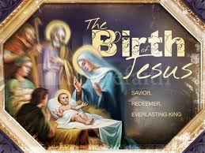
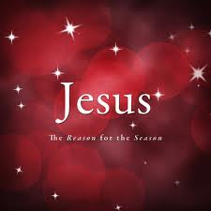
圣诞快乐!
Merry Christmas !

Slide 2
天使在高天歌唱 Angels We Have Heard on High
普世歡騰
Joy to the World

Slide 3
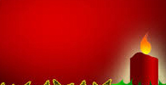
荣耀 荣耀 荣耀归于真神
Gloria, in excelsis Deo! Gloria, in excelsis Deo!

Slide 4
Gloria
荣耀

Slide 5
普世欢腾，救主下降！ Joy to the World , the Lord is come! 大地接她君王 Let earth receive her King 惟愿众心, 预备地方
Let every heart prepare Him room

Slide 6
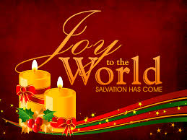
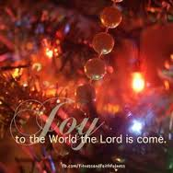
诸天万物歌唱 (x2) And Heaven, and Heaven, and nature sing
诸天，诸天万物歌唱
Let Heaven, let Heaven and nature sing

Slide 7
Gloria
荣耀

Slide 8
普世欢腾，主治万方！ Joy to the World, the Savior reigns!
民众首当歌唱 Let men their songs employ
沃野洪涛，山石平原 While fields and floods, rocks, hills and plains

Slide 9
响应歌声嘹亮 (x2) Repeat the sounding joy (x2)
响应, 响应歌声嘹亮 Repeat, repeat, the sounding joy

Slide 10
Gloria
荣耀

Slide 11
主借真理， 恩治万方！ He rules the World with truth and grace,
要使万邦证明 And makes the nations prove
我主公义，无限荣光 The glories of His righteousness

Slide 12
主爱奇妙莫名(x2) And wonders of His love (x2)
主爱,主爱奇妙莫名
And wonders, wonders of His love

Slide 13
Gloria
荣耀

Slide 14
天使在高天歌唱 甜美声音在人间 高山群岭齐响应 喜乐佳音响不停
.
Angels we have heard on high
Sweetly singing o’er the plains
And the mountains in reply
Echoing their joyous strains

Slide 15
荣耀 荣耀 荣耀归于真神 荣耀 荣耀 荣耀归于至高神
Gloria, in excelsis Deo! Gloria, in excelsis Deo!

Slide 16
Gloria
荣耀

Slide 17
请来到伯利恒城 圣子耶稣已降生 谦卑屈膝来敬拜 耶稣基督新生王
.
Come to Bethlehem and See Him whose birth the angels sing
Come adore on bended knee
Christ the Lord the newborn king

Slide 18
荣耀 荣耀 荣耀归于真神 荣耀 荣耀 荣耀归于至高神
Gloria, in excelsis Deo! Gloria, in excelsis Deo!

Slide 19
Gloria
荣耀

